Slide 1
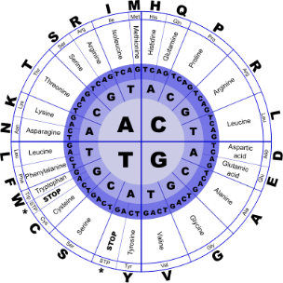
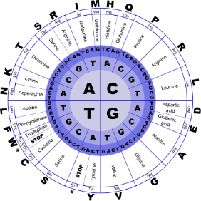


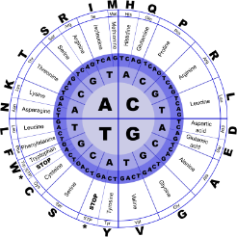
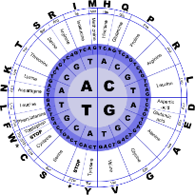
Fundamentals of Programming II
Struct

Slide 2
C++ Data Structure
C/C++ arrays allow you to define variables that combine several data items of the same kind
A data structure is a group of data elements grouped together under one name.
These data elements, known as members, can have different types and different lengths

Slide 3
Syntax
struct type_name
{
member_type1 member_name1; member_type2 member_name2; member_type3 member_name3; . }; Where
type_name is a name for the structure type
Within braces {}, there is a list with the data members, each one is specified with a type and a valid identifier as its name.

Slide 4
Syntax
.
struct Student
{
int studentID;
string name;
short year;
double gpa;
};
structure name
structure members
Notice the required ;

Slide 5
Syntax
.
1. struct names commonly begin with an uppercase letter
2. The structure name is also called the tag
3. Multiple fields of same type can be in a comma-separated list
string name, address;
4. Fields in a structure are all public by default

Slide 6
Syntax
.
.
struct declaration does not allocate memory or create variables
To define variables, use structure tag as type name
Student s1;
s1
studentID
name
year
gpa

Slide 7
Accessing Structure Members
.
.
Use the dot (.) operator to refer to members of struct variables
getline(cin, s1.name);
cin >> s1.studentID;
s1.gpa = 3.75;
Member variables can be used in any manner appropriate for their data type

Slide 8
Displaying struct Members
.
.
To display the contents of a struct variable, you must display each field separately, using the dot operator
Wrong:
cout << s1; // won’t work!
Correct:
cout << s1.studentID << endl;
cout << s1.name << endl;
cout << s1.year << endl;
cout << s1.gpa;

Slide 9
Comparing struct Members
.
.
Similar to displaying a struct, you cannot compare two struct variables directly:
if (s1 >= s2) // won’t work!
Instead, compare member variables:
if (s1.gpa >= s2.gpa) // better

Slide 10
Initializing a Structure
.
.
Cannot initialize members in the structure declaration, because no memory has been allocated yet
struct Student // Illegal
{ // initialization
int studentID = 1145;
string name = "Alex";
short year = 1;
float gpa = 2.95;
};

Slide 11
Initializing a Structure
.
.
Structure members are initialized at the time a structure variable is created
Can initialize a structure variable’s members with either
an initialization list
a constructor

Slide 12
More on Initialization Lists
.
.
Order of list elements matters: First value initializes first data member, second value initializes second data member, etc.
Elements of an initialization list can be constants, variables, or expressions
{12, W, L/W + 1} // initialization list with 3 items

Slide 13
Initialization List Example
.
.
Structure Declaration Structure Variable
struct Dimensions
{ int length;
int width,
int height;
};
Dimensions box = {12,6,3};
box
length
12
width
6
height
3

Slide 14
Partial Initialization
.
.
Can initialize just some members, but cannot skip over members
Dimensions box1 = {12,6}; //OK
Dimensions box2 = {12,,3}; //illegal

Slide 15
Problems with Initialization List
.
.
Can’t omit a value for a member without omitting values for all following members
Does not work on most modern compilers if the structure contains any string objects
Will, however, work with C-string members

Slide 16
Nested Structures
.
.
A structure can have another structure as a member
struct PersonInfo
{ string name;
string address;
string city;
};
struct Student
{ int studentID;
PersonInfo pData;
short year;
double gpa;
};

Slide 17
Members of Nested Structures
.
.
Use the dot operator multiple times to access fields of nested structures
Student s5;
s5.pData.name = "Joanne";
s5.pData.city = "Tulsa";

Slide 18
Structures as Function Arguments
.
.
May pass members of struct variables to functions
computeGPA(s1.gpa);
May pass entire struct variables to functions
showData(s5);
Can use reference parameter if function needs to modify contents of structure variable

Slide 19
Structures as Function Arguments
.
.
May pass members of struct variables to functions
computeGPA(s1.gpa);
May pass entire struct variables to functions
showData(s5);
Can use reference parameter if function needs to modify contents of structure variable

Slide 20
Notes on Passing Structures
.
.
Using a value parameter for structure can slow down a program and waste space
Using a reference parameter speeds up program, but allows the function to modify data in the structure
To save space and time, while protecting structure data that should not be changed, use a const reference parameter
void showData(const Student &s)
// header

Slide 21
Returning a Structure from a Function
.
.
Function can return a struct
Student getStuData(); // prototype
s1 = getStuData(); // call
Function must define a local structure variable
for internal use
to use with return statement

Slide 22
Returning a Structure from a Function
.
.
Student getStuData()
{ Student s; // local variable
cin >> s.studentID;
cin.ignore();
getline(cin, s.pData.name);
getline(cin, s.pData.address);
getline(cin, s.pData.city);
cin >> s.year;
cin >> s.gpa;
return s;
}

Slide 23
Example
.
.
struct product
{ int weight;
double price; } ;
In function deceleration –
product apple;
product banana, melon;
This declares a structure type, called product, and defines it having two members: weight and price, each of a different fundamental type.
This declaration creates a new type (product), which is then used to declare three objects (variables) of this type: apple, banana, and melon.
Note how once product is declared, it is used just like any other type.

Slide 24
Example
.
.
struct product
{ int weight;
double price;
} apple, banana, melon;
where object_names are specified, the type name (product) becomes optional:
struct requires either a type_name
or
at least one name in object_names,
but not necessarily both.

Slide 25
Example
.
.
Once the three objects of a determined structure type are declared (apple, banana, and melon) its members can be accessed directly.
The syntax for that is simply to insert a dot (.) between the object name and the member name.
For example, we could operate with any of these elements as if they were standard variables of their respective types:
apple.weight
apple.price
banana.weight
banana.price
melon.weight
melon.price

Slide 26
Initialize struct
.
.
struct Employee
{
short id;
int age;
double wage;
};
Employee joe = { 1, 32, 60000.0 };
// joe.id = 1, joe.age = 32, joe.wage = 60000.0
Employee frank = { 2, 28 };
// frank.id = 2, frank.age = 28, frank.wage = ??? (uninitialized)

Slide 27
Initialize struct
.
.
struct Triangle
{
double length = 1.0;
double width = 1.0;
};
int main()
{
Triangle x; // length = 1.0, width = 1.0
x.length = 2.0;
return 0;
}

Slide 28
Nested struct
.
.
struct Employee
{
short id;
int age;
float wage;
};
struct Company
{
Employee CEO; // Employee is a struct within the Company struct
int numberOfEmployees;
};
Company myCompany = {{ 1, 42, 60000.0f }, 5 };

Slide 29
Problem #1
.
.
You are running a website, and you are trying to keep track of how much money you make per day from advertising.
Declare an advertising struct that keeps track of how many ads you’ve shown to readers, what percentage of users clicked on ads, and how much you earned on average from each ad that was clicked.
Read in values for each of these fields from the user.
Pass the advertising struct to a function that prints each of the values, and then calculates how much you made for that day (multiply all 3 fields together)

Slide 30
Problem #2
.
.
Create a struct to hold a fraction.
The struct should have an integer numerator and an integer denominator member.
Declare 2 fraction variables and read them in from the user.
Write a function called multiply that takes both fractions, multiplies them together, and prints the result out as a decimal number.
You do not need to reduce the fraction to its lowest terms.

